Slide 1

The Dolphin
Requirements
& Test Plans
Group 18:
Kandayce Burks
Dieu Do
Luis Hernandez
Brent Yurek

Slide 2
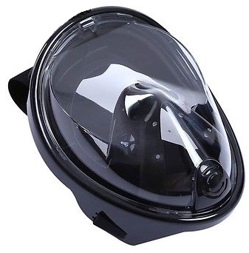
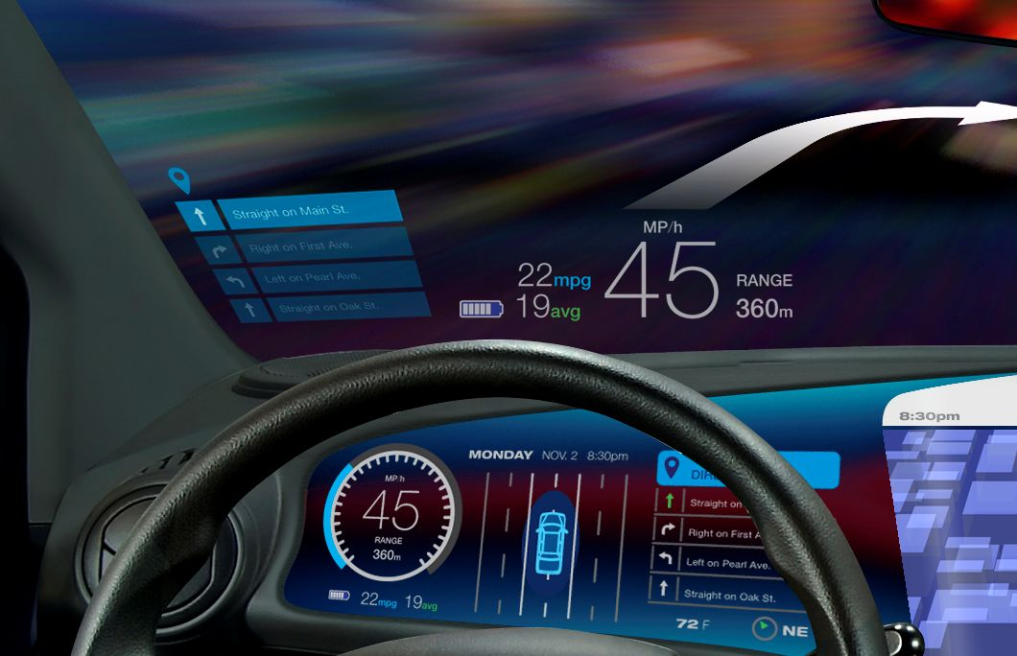
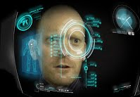
What is The Dolphin?
Scuba mask
Full Face mask
HUD display

Slide 3
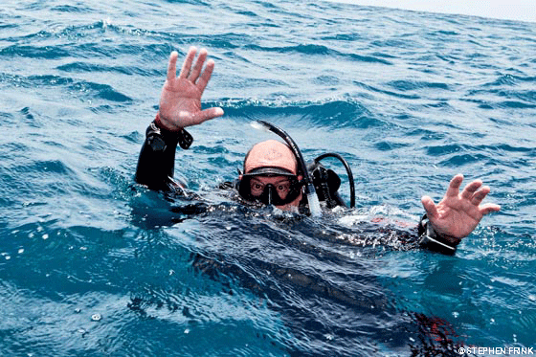
Provides users with Vital information for diving
Air time remaining
Current depth
Dive time elapsed
Air tank pressure
User will not have to manually calculate
Less human error
More precise

Slide 4
Sonar Mapping
Provides sonar map of diver’s surrounding
Real time
Up to 100 meter radius

Slide 5
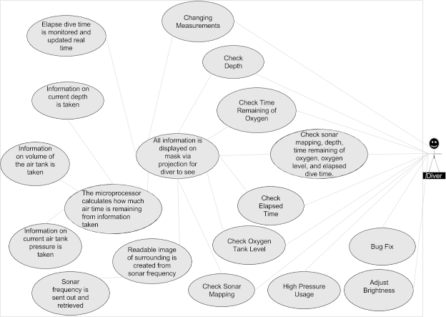
Use Cases

Slide 6
Requirements

Slide 7
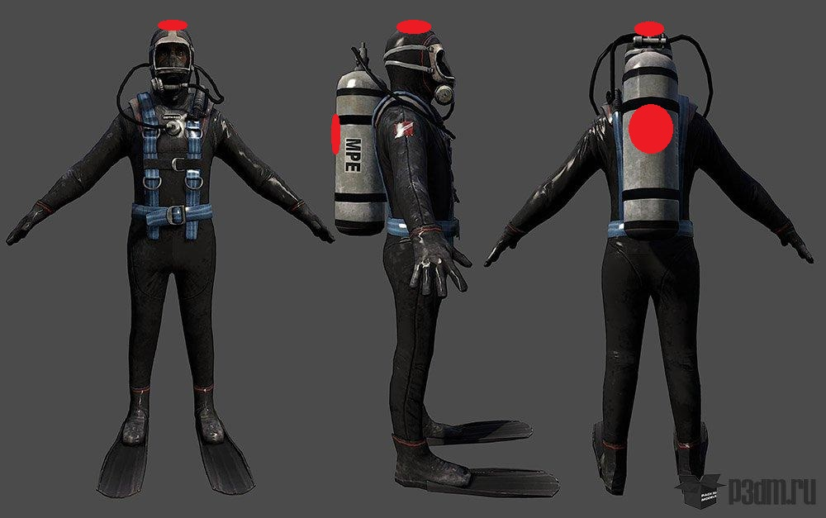
Functional Requirements
Measurements conversion
Brightness adjustments
Display Vitals
Switch between sonars

Slide 8

Speed & Latency Requirements
System cannot have considerable lag!
Calculations must be done in <.5 seconds
System response time after user’s button press is 1.5 seconds
System retrieves sonar data every .5 seconds
Accurate sonar map in real time

Slide 9
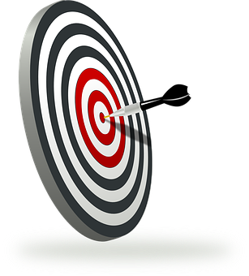
Precision Requirements
Remaining time before oxygen runs out calculation + 1 minute
Current time has to be + .1 seconds from actual time

Slide 10
Safety-Critical Requirements
HUD limitations
Must not take up more than 25% of screen
Information must be relevant and not distracting
Offer size adjustment for user preference
Materials used must not be hazardous to users
Must be able to function under high pressure
Withstand pressure levels of ~100+ meters of depth
IP69k certified

Slide 11
Usability Requirements
Easy to understand
Users can pick up the product and learn how to use it within 15 minutes to 1 hour
Intuitive
Does not need extensive knowledge to use
Users can set preferences
Metrics
Language

Slide 12
Test Plans

Slide 13
Features tested
HUD projection
Is projection working? / is correct data being projected?
Vital Calculations
Are calculations correct or within the 2% error margin?
Sonar Mapping
Is the image correct? / is there an image created?
Water Pressure
Can it withstand 100 meters? / does it meet IP69k standards?

Slide 14
Approach
Stress test
Repeated test each function
Test functionality at 100 meters depth
Perform tests at simulated environment that has same water pressure levels as 100 meters of depth
Suspension
<30% functionality
Resumption
>60% & <90% functionality

Slide 15
Test Cases
Testing will be conducted once per week
It will be done in water pressure levels of ~100 meters of depth
HUD responses
Displays correct calculations
Sonar imagery
Durability

Slide 16
